Slide 1
Data Science on Cloud Pak for Data 3.x Development Tools Elena Lowery, Data Science and AI, WW Team

Slide 2
Agenda
User roles
Projects
Data Access
Working with Open Source Tools

Slide 3
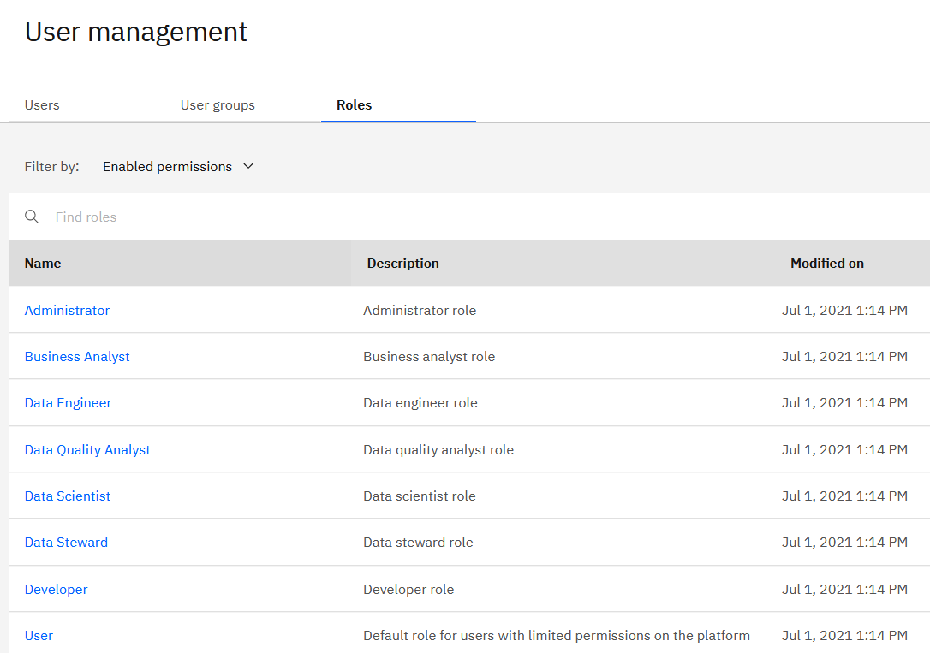
User roles
Cloud Pak for Data supports platform and Project/Deployment Spaces user roles
Platform roles
Predefined, new roles can be created – select from available permissions
Can be assigned to users or groups
Projects and Deployment Spaces
Admin, Editor, Viewer
Demo
Notes:
Roles documentation: https://www.ibm.com/docs/en/cloud-paks/cp-data/3.5.0?topic=users-predefined-roles-permissions

Slide 4
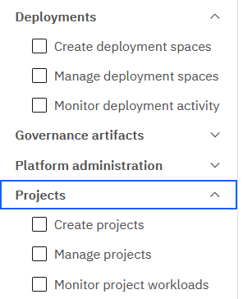
User roles – changes in version 4.x
Demo
More granular permissions for projects, deployment spaces, and workload monitoring
Notes:
Roles in documentation: https://www.ibm.com/docs/en/cloud-paks/cp-data/4.0?topic=users-predefined-roles-permissions

Slide 5
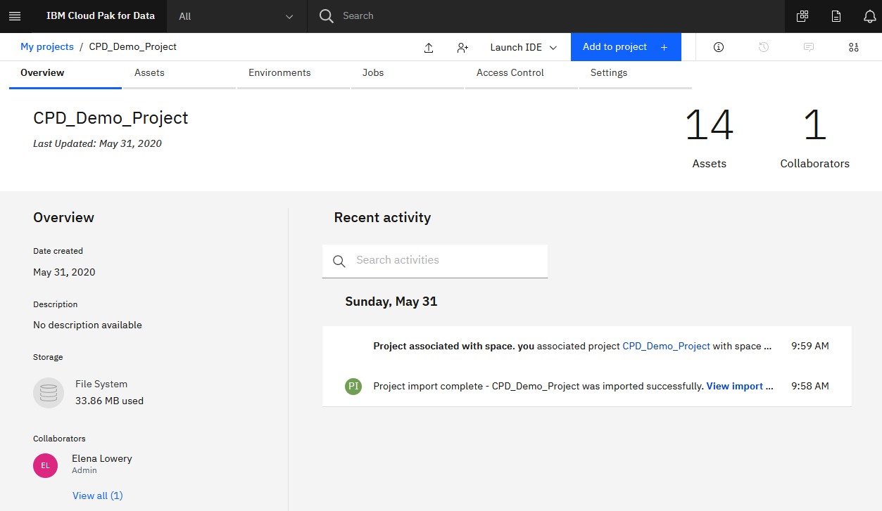
Projects
Projects in Watson Studio
Contain all assets developed in IDEs (Jupyter Notebook, models, scripts, etc.)
Can be exported/imported
Can be integrated with Git
Support collaborators
Support multiple environments: hardware configuration and packages
Sensitive and auditing options
Connect to deployment interface
Demo
Notes:
Demo creating a project and importing a project

Slide 6
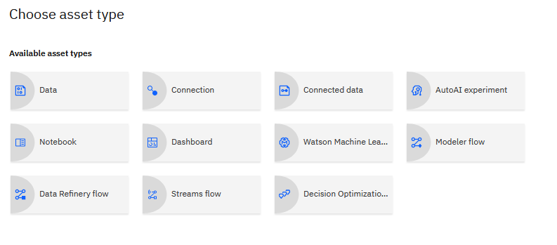
Projects
Adding an asset to a project
Select Add to Project
If an asset type is not displayed, then the service has not been installed – check with the administrator
JupyterLab and RStudio are packaged as “IDEs”:
New notebooks and R projects are created using the IDE menu
Demo
Notes:
Demo – adding a notebook

Slide 7
Projects: Connecting to Data
Types of data assets
Connected data: data that resides in an external data source: databases, Cloud Storage, Hadoop, etc.
Create a Connection
Create Connected Data: points to a specific asset in the data source (i.e. table, file)
Data: a file that’s imported into the project
Browse to the file and import
Demo
Notes:
Demo – adding data and connected data

Slide 8
Connections and Data Access Options
Connection Type | Supported options | When to use | Owner/creator | Comments
Platform | All supported connection types, but not data assets | When the same connection can be reused in multiple projects | Platform administrator, data engineer | Supports shared credentials, but not recommended Platform connections can be added to projects or catalogs
Project | All supported connection types and data assets | When the connection is specific to a project | Platform administrator, data engineer, data scientist | Supports shared credentials, but not recommended Data Assets can be promoted to Deployment Spaces
Catalog | All supported connection types and data assets can be added to the catalog | When the administrator wants to make it easier for users to find connections and data assets | Platform administrator, data engineer, data steward, data scientist | Connection objects and data assets are copied into the project

Slide 9


Traditional process of acquiring data for data science
Data Engineer
Configure connections to data sources typically used by the data science team
Security is provided by data sources
Run ETL jobs
Submit request for new data sources via external communication
Use data sources
Data scientist
Notes:
The process of configuring data sources that I have shown you so far is the traditional process that’s used by many data science teams.

Slide 10
ModelOps process on Cloud Pak for Data
Data Engineer
Run ETL jobs
Virtualize data (optional)
Add assets to the catalog
Configure connections to data sources typically used by the data science team
Security is provided by data sources
Governance is provided by the catalog
Search for data in the catalog
If data is not found, submit a request
Use data sources , virtualized data, and assets from the catalog (data sources, tables, files, etc.
Data scientist
Notes:
With ModelOps capabilities on Cloud Pak for data, we can enhance this process.
First, in addition to ETL, a data engineer can virtualize the data and add assets to the catalog. Once assets are added to the catalog, it becomes much easier for the data scientist to find and request data.

Slide 11
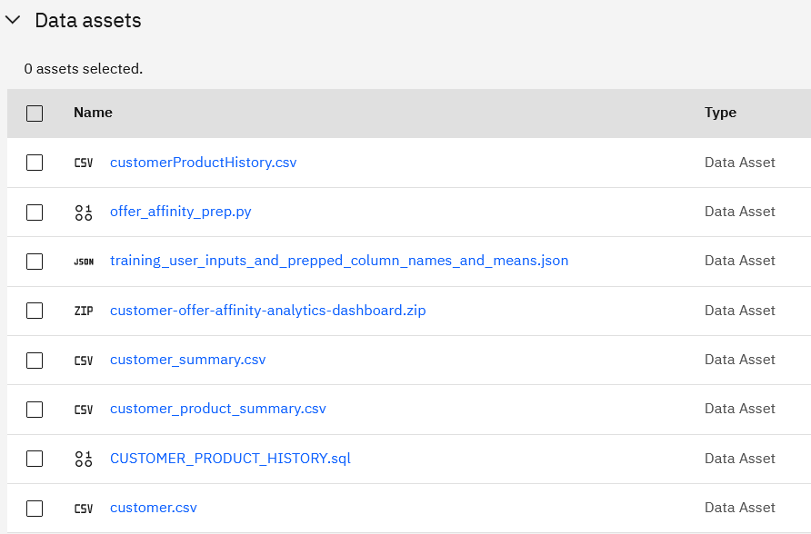
Projects: Connecting to Data
Demo
Data
Upload any file type to Data Assets
No limitations other than HTTP/browser limitation for file size upload
The file is stored in Cloud Pak for Data
Internally it’s stored on the storage node of the cluster
It should be accessed with Project API
Use code generation in notebooks and documentation to learn about project-lib API (Python and R) and Watson Data API (REST)
Notes:
Project-lib API: https://www.ibm.com/docs/en/cloud-paks/cp-data/3.5.0?topic=notebook-using-project-lib-python
Watson Data API: https://cloud.ibm.com/apidocs/watson-data-api-cpd

Slide 12
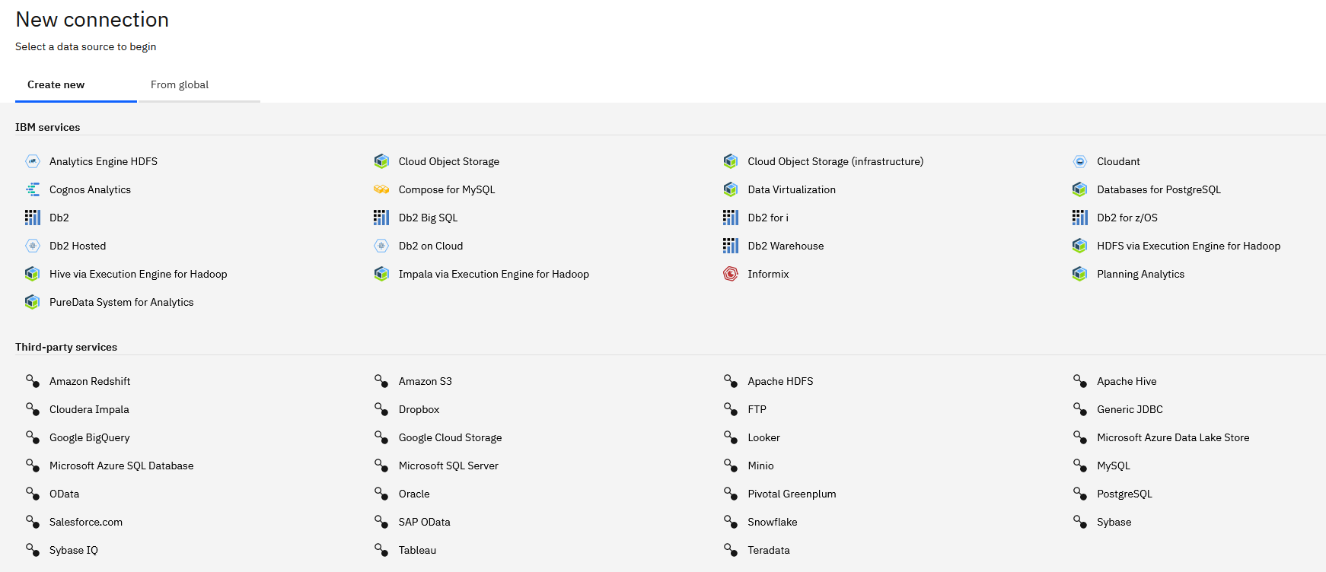
Projects: Connecting to Data
Create a Connection
Demo
Notes:
Demo – adding data and connected data

Slide 13
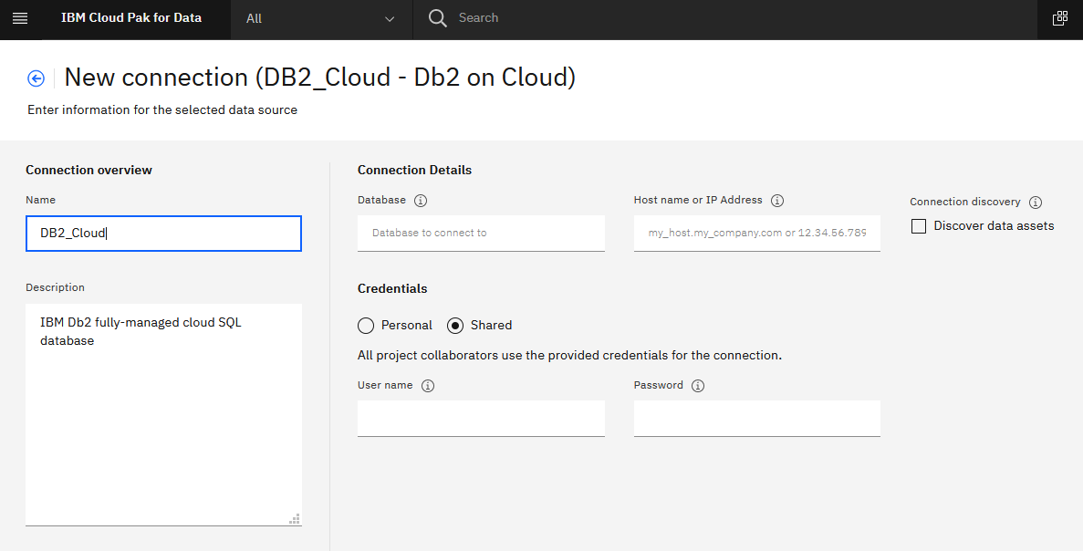
Projects: Connecting to Data
Create a Connection
Get connection information from your database administrator
Notice the option between personal and shared credentials
Optionally, use the Discover data assets option
All tables will be added as connected data
Demo
Notes:
Demo – adding data and connected data

Slide 14
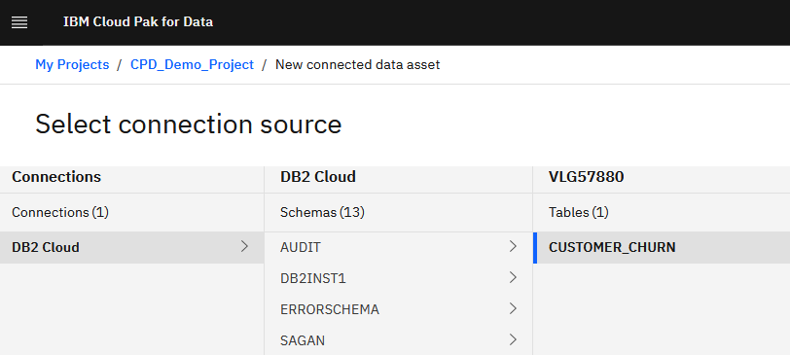
Projects: Connecting to Data
Create Connected Data
Select Add to project -> Connected data
Connected data is not stored in the project, it’s loaded when it’s used
Demo
Notes:
Demo – adding data and connected data

Slide 15
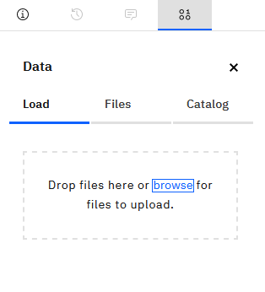
Projects: Connecting to Data
Load data
Select Add to project -> Data
Data is stored in the project
Similar to connected data, it does not get loaded into memory until it’s used
But it does take up disk space and depending on system setup, can be replicated between the nodes of the cluster, which can affect performance
If you have gigabytes of data (flat files), consider storing them in external storage
Demo
Notes:
Demo – adding data and connected data

Slide 16
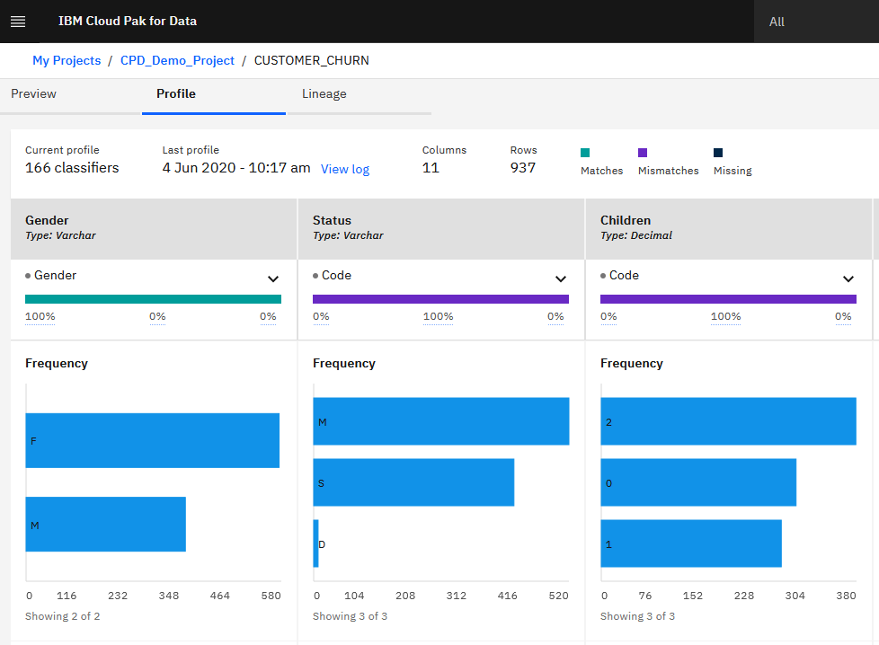
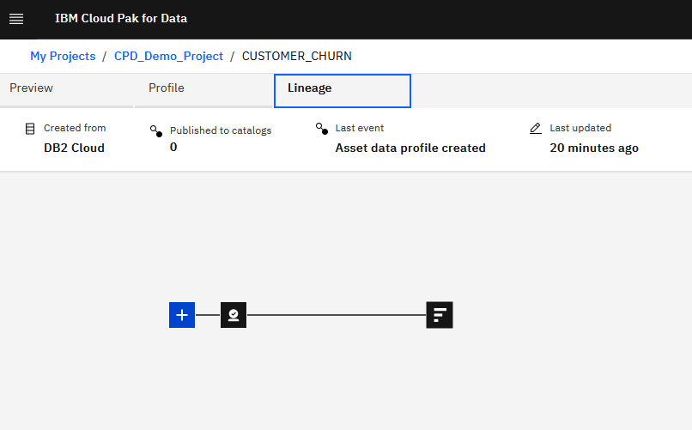
Projects: Connecting to Data
Data Preview, Profile, and Lineage
Click on the asset in the Data Assets view to open the Preview screen
Profile task is performed by Watson Knowledge Catalog (WKC) service
The service has to be installed to complete the task
Lineage
Keeps a timeline of events related to the data asset
Demo
Notes:
Demo – adding data and connected data

Slide 17
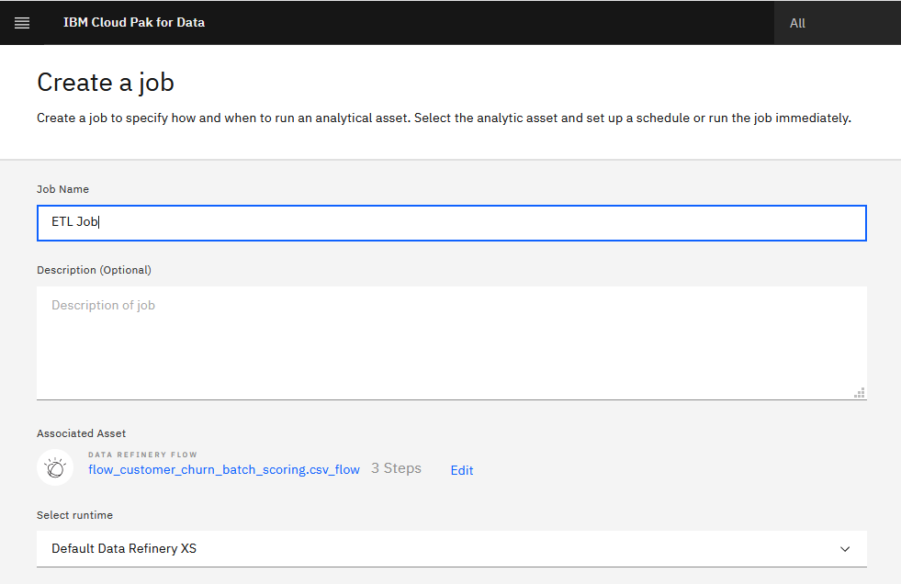
Projects: Connecting to Data
Data Refinery
Data refinery is a lightweight ETL tool that creates data transformation scripts via UI
Scripts can run as batch jobs
Demo
Notes:
Demo – adding data and connected data

Slide 18
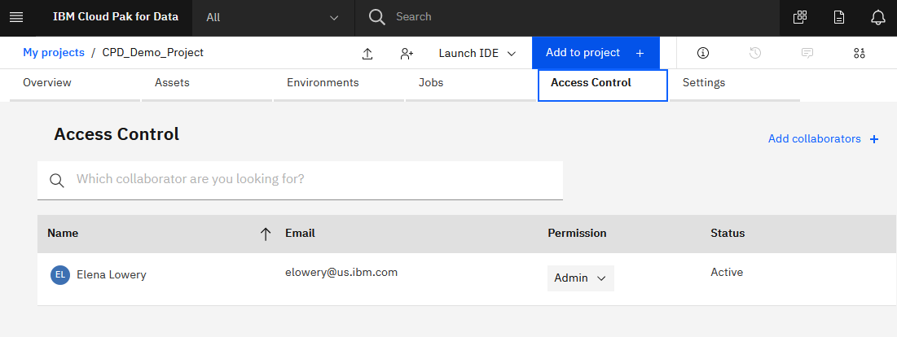
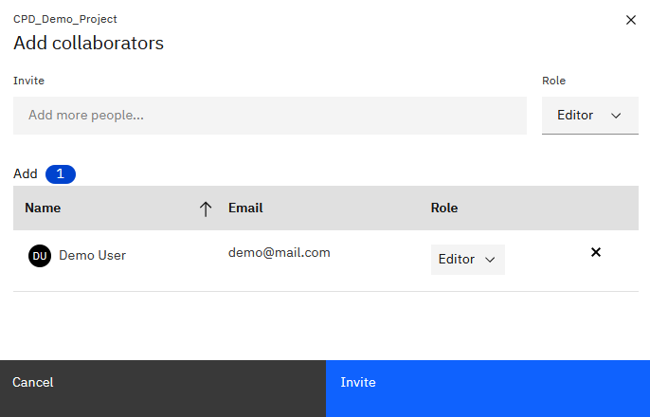
Projects: Collaborators
Add collaborators
Click on the Access Control tab
Search for a user
A userid must already exist in the system
Created by the admin
Select a role:
Viewer: read only
Editor: edit, add and remove assets
Admin: Editor + delete project
Demo
Notes:
Demo – adding users

Slide 19
Projects: Collaborators
Topics we will cover later
Locking assets while editing
Merging changes/conflict resolution
Demo
Notes:
Demo – adding users

Slide 20
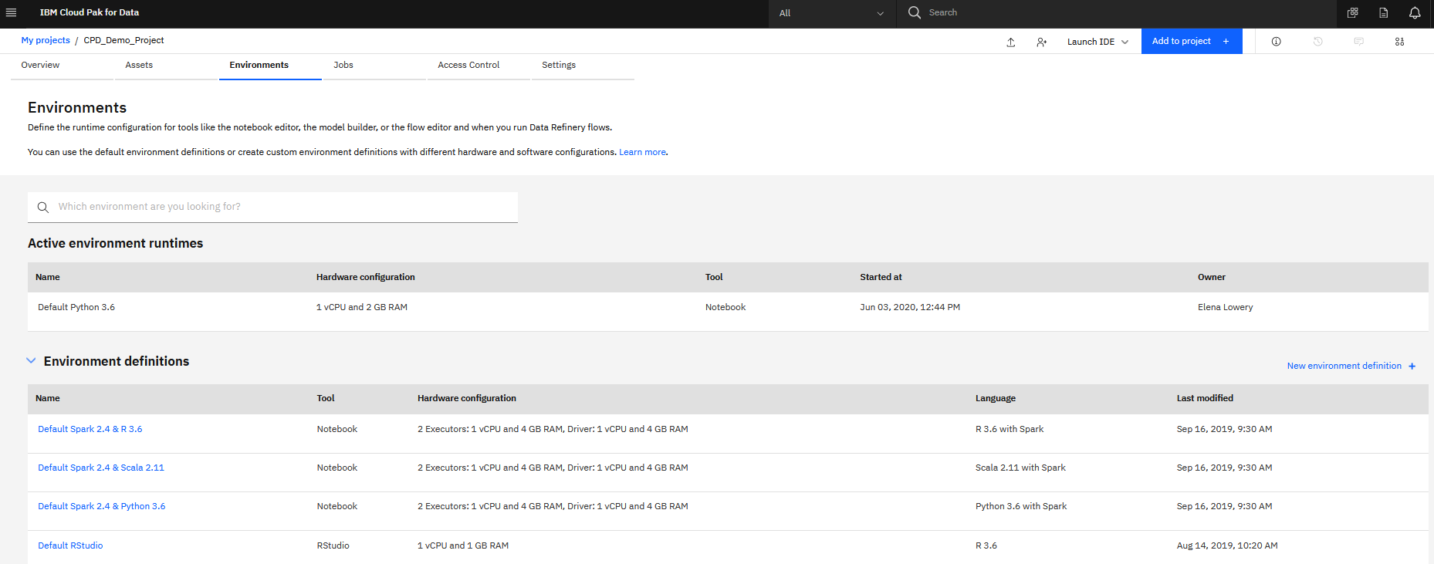
Projects: Environments
What is an environment?
Every time we open an IDE (notebook, RStudio), it starts a new process
We can configure settings for this process
Hardware resources
Packages/libraries that will be loaded
Watson Studio includes several default environments
Python, R, Spark
Customizations are for hardware resources and packages only, not for different versions of Python, R, Spark
Demo
Notes:
Demo – default and custom environments

Slide 21
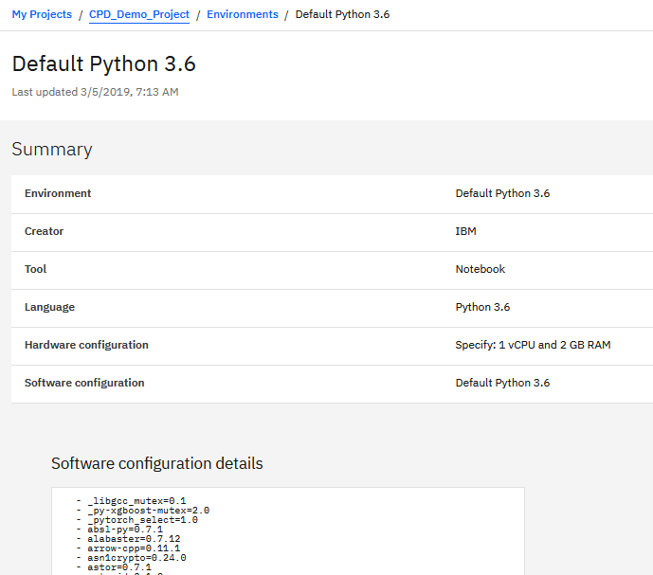
Projects: Environments
What is in the default configuration?
Click on the environment definition to review the configuration
Demo
Notes:
Demo – default and custom environments

Slide 22
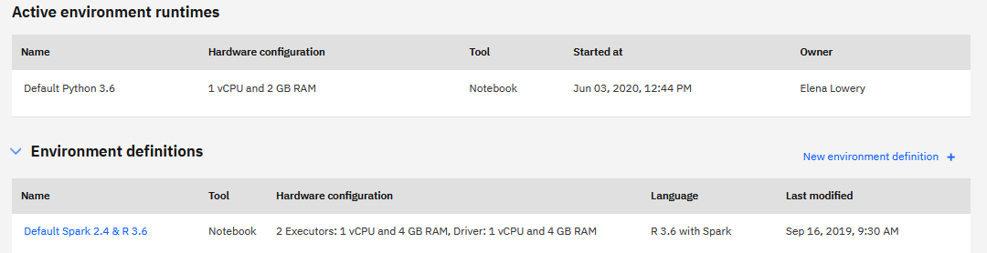
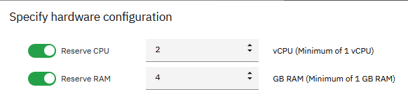
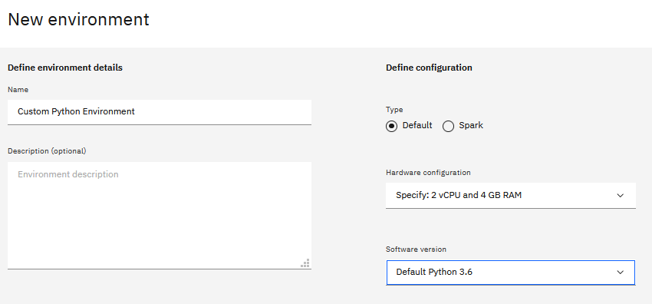
Projects: Environments
Create a new environment configuration
Click New Environment in the project Environments view
Specify hardware configuration
A single reserved environment for Python and R should not exceed the size of the node in the cluster
Check with system admin re. the size of each node
Make the environment no more than 70 percent of the node size
Example: 24-core node, the environment should not be more than 16 VPCs
At this time the UI will not prevent you from specifying more resources than should be used, but when you try to start this environment, you will get a message “Resources not available”.
Demo
Notes:
Demo – default and custom environments

Slide 23
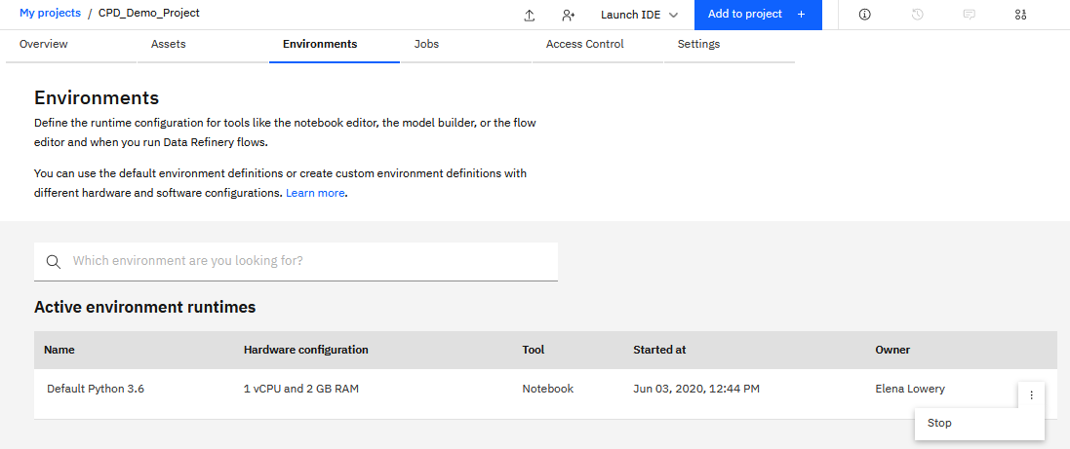
Projects: Environments
Best practices for optimal system utilization
Start with default configurations
Do not request more resources than needed
Stop environments that you are not using
Idle environments are stopped after 18 hours
Important:
Environments are provisioned in each project
If a user opens a notebook in 2 different projects, then 2 environments are provisioned
Environments are provisioned per user/per project/per environment configuration
Demo
Notes:
Demo – default and custom environments

Slide 24
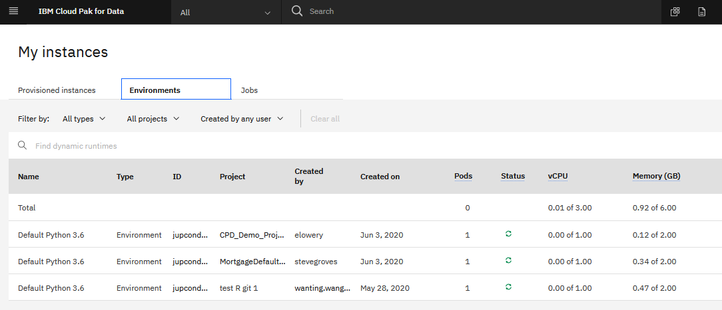
Projects: Environments
An administrator can view and stop all active runtimes
From main menu select My Instances
Click on Environments
If needed, use the Delete option for each environment
Demo
Notes:
Demo – default and custom environments

Slide 25

Environment customization
Option 1
Option 2
Test: use pip install or conda install in notebooks to test
Persist: yaml config for each environment
Use environment
Usage
Option 1: allows quick testing
Option 2: standard, quick configuration
Option 3 : governance and advanced customization (CPD 3.0 and later)
Data scientist
Use environment if collaborator
Use environment
Data scientist
Option 3 *
Customize environments with docker file: packages, files, OS settings
Upload and register environment
Admin

Slide 26
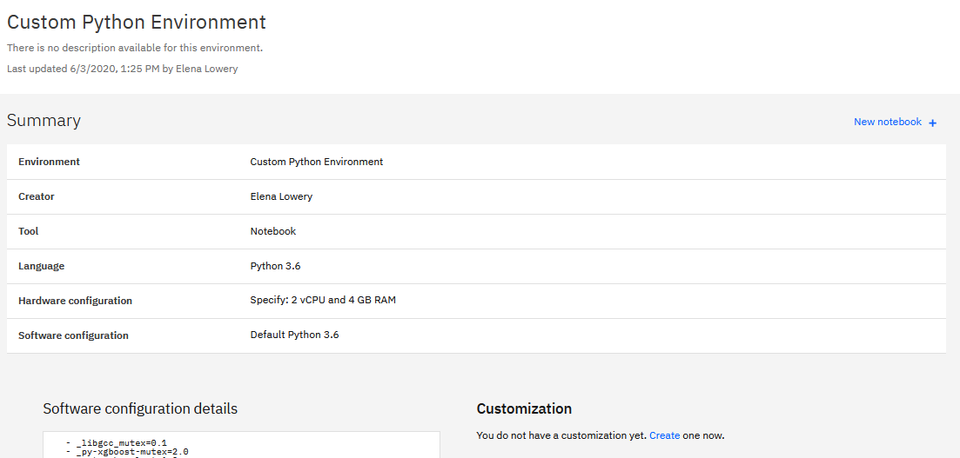
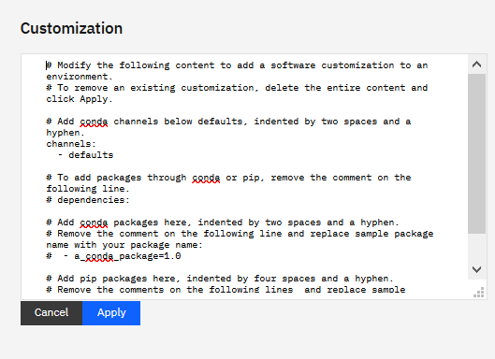
Projects: Environments
Create a new environment configuration - packages
Specify packages that need to be loaded
Standard Conda yaml format
While pip install and conda install commands work in notebooks, the libraries will not persist in the environment (will not be loaded) and will not be available to collaborators
Customization with yaml should be used after testing
Packages will be loaded at environment startup each time
If packages take too long to load, consider building and loading custom images (done by admin)
Demo
Notes:
Demo – default and custom environments

Slide 27


Projects: Environments
Administrator task: create an image
A new custom image is built using a Dockerfile using an existing CPD runtime image as base image
Base image is downloaded from CPD and modified on outside of CPD
In addition to pip & conda packages, operating system dependencies can be installed using microdnf
Modified image is uploaded to CPD
Container Registry
Dockerfile
Custom
Image

Slide 28
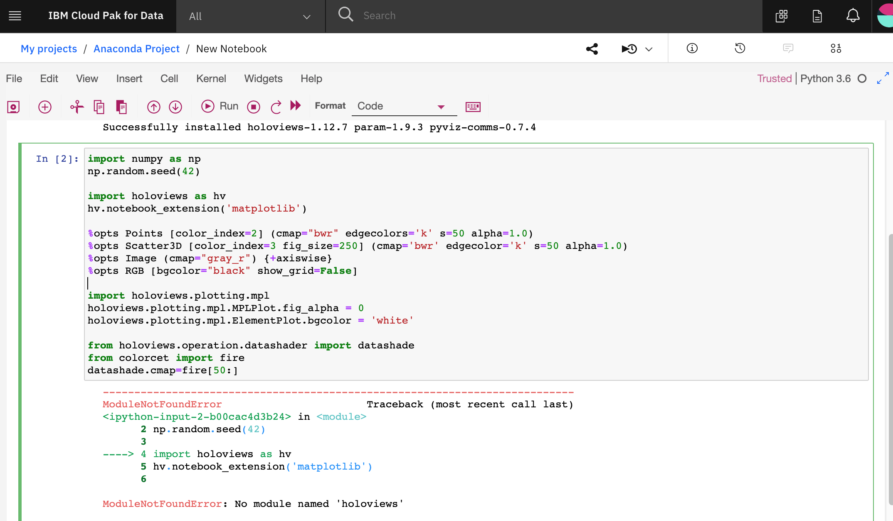
Package Management with Anaconda
Watson Studio Notebook
Watson Studio Environment
Anaconda Repository
1
CLIENT
Requests
2
3
NGINX PROXY
Environment n
INTERNAL PROXY
Environment 2
REPO API
FILE SYSTEM
Environment 1
Hardware Configuration
POSTGRES
Software Configuration
DISPATCHER
SCHEDULER
REDIS
WORKERS
© Copyright IBM Corporation 2020
Notes:
Packages in Watson Studio can be managed by Anaconda repository.
After Anaconda Repository has been configured, previously described Option1 (install packages in a notebook) and Option 2 (configure yaml file for the environment) can be used. The packages will be loaded from the channel defined in Anaconda Repository.
At this time Notebooks are supported. RStudio support is on the roadmap.

Slide 29
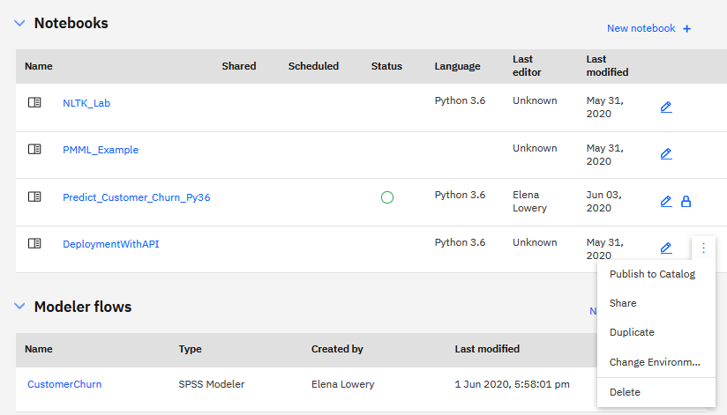
Projects: Environments
Starting environments
When you first open an asset (for example, a notebook), it opens in the default environment
To change the associated environment, make sure the notebook is not running
Next startup will load the new environment
Demo
Notes:
Demo – default and custom environments

Slide 30
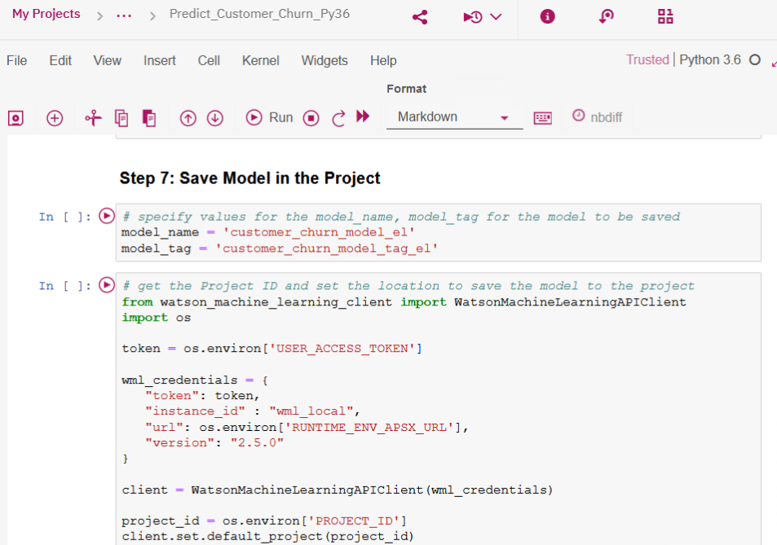
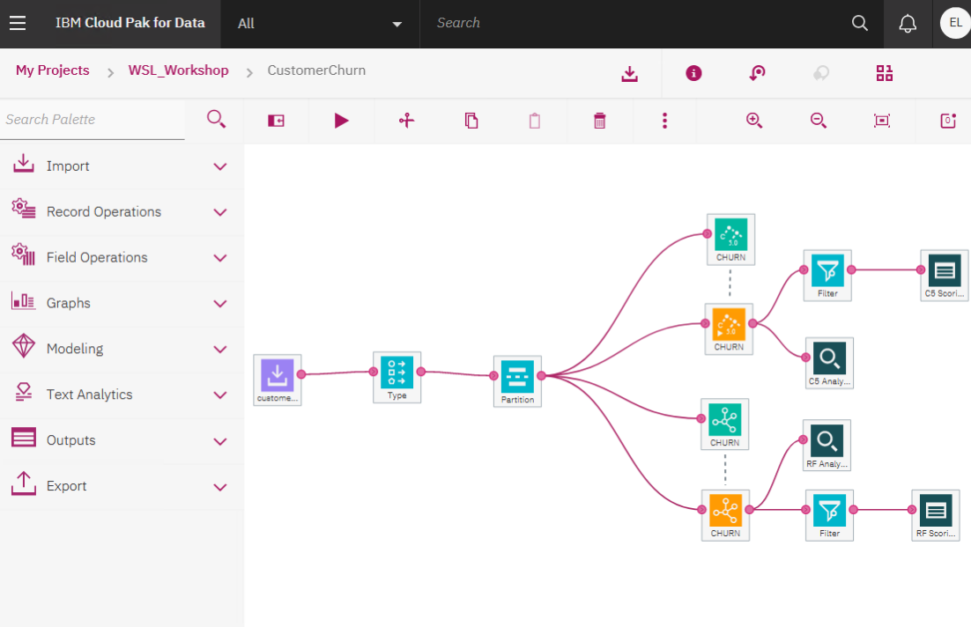
Collaboration and Git Integration
Under
Watson Studio provides 3 options of collaboration and Git integration
Option 1: local collaboration
No Git integration
One copy of all assets
Assets are locked during edit, and changes are immediately available to collaborators
No merge necessary
Versioning: default support in IDEs (notebooks)
Collaborator 1
Project assets: 1 copy
Edit
Collaborator 2
View only until unlocked by collaborator 2 or admin
Notes:
Git documentation in CP4D: https://www.ibm.com/support/knowledgecenter/en/SSQNUZ_2.5.0/wsj/manage-data/git-integration.html

Slide 31
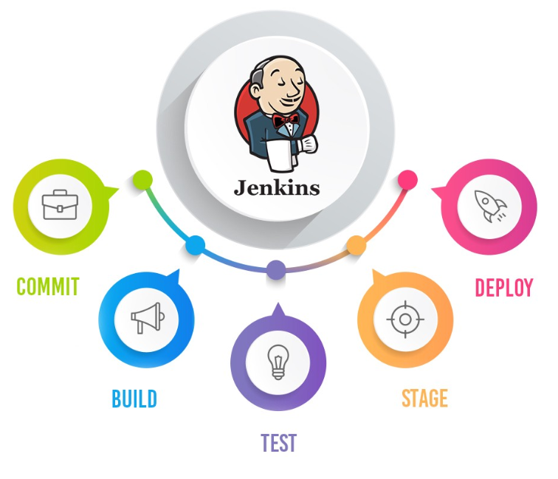

Under
Collaboration and Git Integration
Option 2: Project-level Git integration for non-Jupyter Lab
One copy of all assets for project collaborators
Git is used primarily for CI/CD (using a tool outside of Watson Studio)
No merge conflict resolution
Collaborator 1
Project assets: 1 copy
Edit
CI/CD Tool
Push/pull
View only until unlocked by collaborator 2 or admin
CI/CD
Git
repo
Push/pull
Edit
Collaborator 2
Notes:
General education about Git workflow:
https://www.atlassian.com/git/tutorials/comparing-workflows

Slide 32
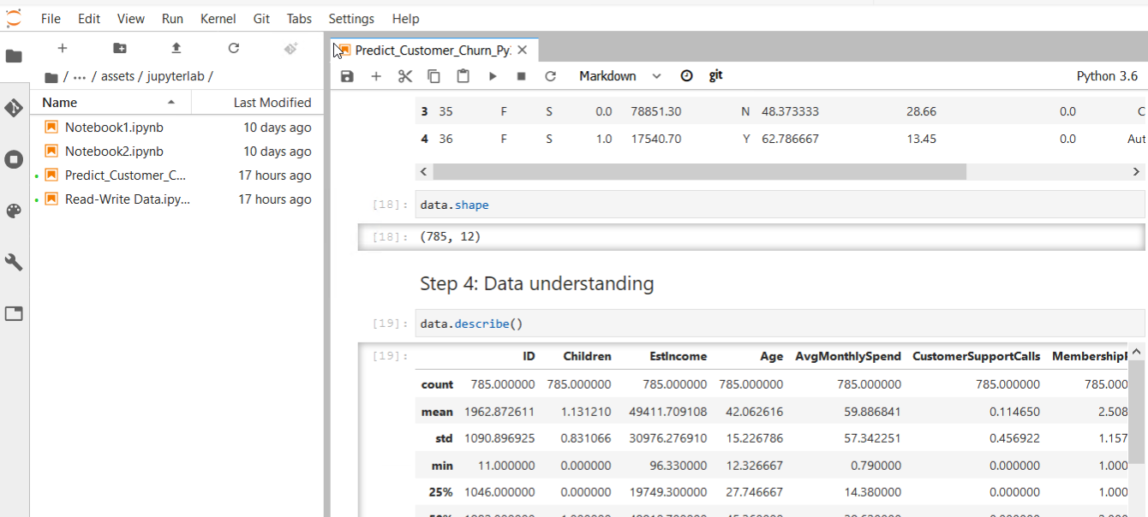
Collaboration and Git Integration
Under
Option 3: Project-level Git integration for JupyterLab
Git integration is done with JupyterLab git extension
Typical git process
Merge conflict resolution in JupyterLab
JupyterLab assets: copy per collaborator
Git repo
Push/pull
Push/pull
JupyterLab
JupyterLab
CI/CD Tool
Notes:
General education about Git workflow:
https://www.atlassian.com/git/tutorials/comparing-workflows

Slide 33
Collaboration and Git Integration
Topics we will cover later
Versioning of models
Promotion of assets to production
Which option should be used?
If you are planning to use JupyterLab or RStudio, then Git integration is required
Git integration is not required for any other capability
Deployment, backup, etc. are built-in functions in CPD
Optionally, Git integration can be used for project export
If Git is used for automation of other workflows
Notes:
Demo – adding users

Slide 34
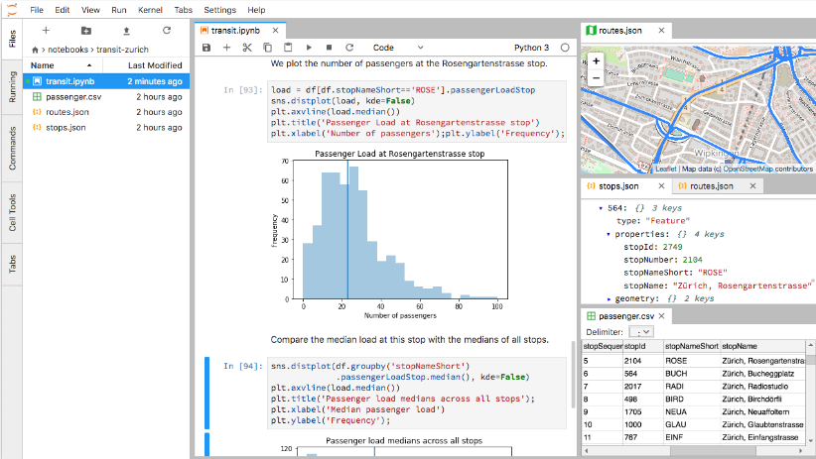
Open source tools
Tools
Jupyter notebook: Python, R, Spark
JupyterLab: Python, Spark
RStudio
To look up versions
Use menus in IDEs (Help -> About)
Preloaded libraries
Use Environment view in projects or pip / conda commands

Slide 35
Open source tools
Load any package / library
Via environment customizations
Customize runtime environment configuration
Processors and memory
Access data
Code generation for all defined data sources: pandas data frames and Spark data frames
Schedule notebooks to run as a job
Publish notebooks as a URL
Download notebooks as individual files or as a project

Slide 36
JupyterLab in Watson Studio
JupyterLab requires a connection to a Git repo
JupyterLab supports Python 3.6 and Spark 2.4
In a single Watson Studio project you can have a JupyterLab IDE OR a Jupyter Notebook IDE (not both)
JupyterLab environment maintains its own file structure that’s not available in the project by default
Extensions available in JupyterLab: git and nbdime
Other extensions can’t be loaded
Notes:
JupyterLab documentation page in CP4D: https://www.ibm.com/support/knowledgecenter/en/SSQNUZ_2.5.0/wsj/analyze-data/jupyterlab.html

Slide 37
Demo: Working with Notebooks and with Jupyter Lab

Slide 38
Hands-on lab
Projects
Data Access
Collaboration and Git Integration
Package and environment management
JupyterLab

Slide 39
Package Management Deep Dive

Slide 40
Projects: Environments
What is an environment?
Every time we open an IDE (Jupyter, RStudio), it starts a new process (a pod in Kubernetes)
We can configure settings for this process
Hardware resources
Packages/libraries that will be loaded
Watson Studio includes several default environments
Python, R, Spark
Customizations are for hardware resources and packages only, not for different versions of Python, R, Spark
Demo
Notes:
Demo – default and custom environments

Slide 41
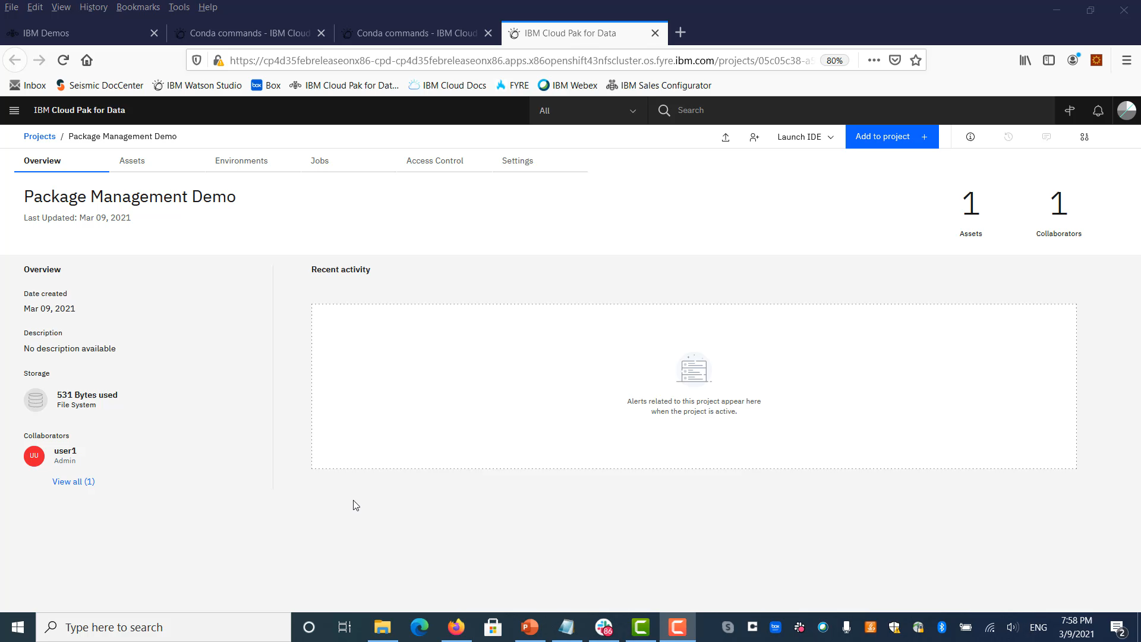
Environments: Overview
Notes:
Demo – brief overview of environments

Slide 42
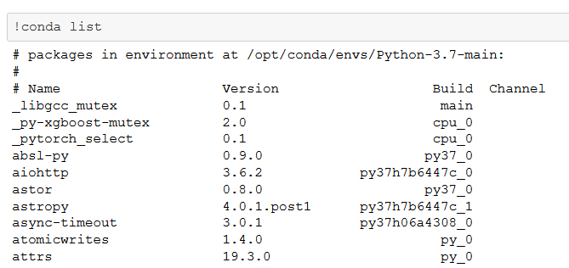
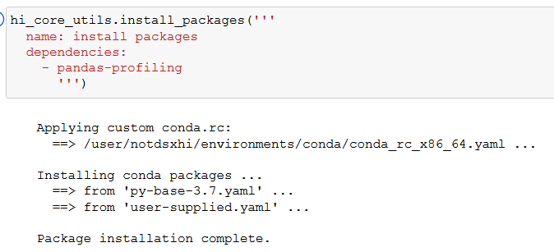
Projects: Environments – Local and Remote
Environments are available for both local and remote execution
Local: runs on Cloud Pak for Data cluster
Remote: runs on supported Hadoop cluster
Customizations (loading packages, modifying hardware resources) that we will discuss next apply to both local and remote environments
Notes:
Demo – default and custom environments

Slide 43
Projects: Environments
What is in the default configuration?
Click on the environment definition to review the configuration
Demo
Notes:
Demo – default and custom environments

Slide 44
Environment customization: local environments
Option 1
Option 2
Test (load): use pip install or conda install in notebooks to test
Declare (load): yaml config for each environment
Use environment
Usage
Option 1: allows quick testing
Option 2: standard, quick configuration
Option 3 *: governance and advanced customization (CPD 3.0 and later)
Data scientist
Use environment if collaborator
Use environment
Data scientist
Option 3 *
Customize (pre-load) environments with docker file: packages, files, OS settings
Upload and register environment
Admin

Slide 45
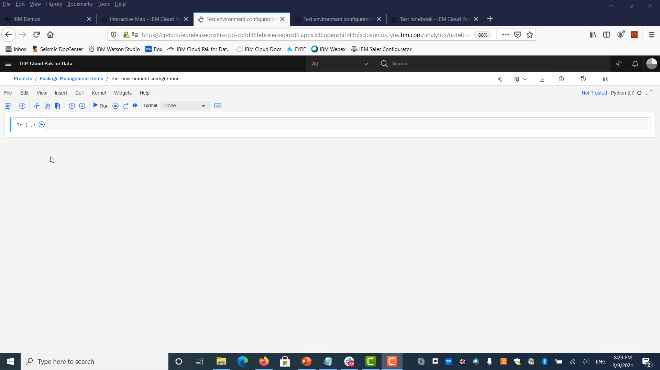
Local environment: Option 1 – conda install
Notes:
Demo – Option 1 (conda install). We are showing installation of pandas-profiling package

Slide 46
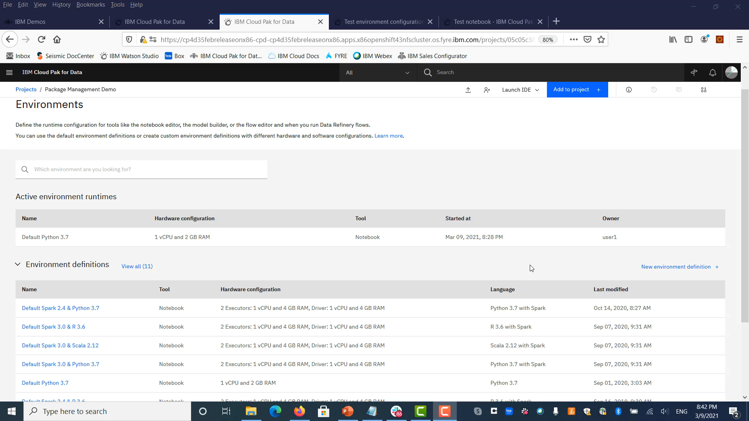
Local environment: Option 2 – yaml file install
Notes:
Demo – Option 2 (yaml file config). We are showing installation of pandas-profiling package

Slide 47
Environment customization: remote environments
Option 1
Option 2
Load: use Hadoop helper API to install packages
Load from Anaconda Repository: load approved packages
Use environment
Usage
Option 1: allows quick testing
Option 2: standard, quick configuration
Option 3 *: governance and advanced customization (CPD 3.0 and later)
Data scientist
Use environment if collaborator
Use environment
Data scientist
Option 3 *
Customize (pre-load) environments with docker file: packages, files, OS settings
Upload and register environment
Admin

Slide 48
Remote environment: Overview
Notes:
Demo – brief overview of remote environments (46th second)

Slide 49
Projects: Environments
Create a new environment configuration
Click New Environment in the project Environments view
Specify hardware configuration
Reserved is recommended
A single reserved environment for Python and R should not exceed the size of the node in the cluster
Check with system admin re. the size of each node
Make the environment no more than 70 percent of the node size
Example: 24-core node, the environment should not be more than 16 VPCs
At this time the UI will not prevent you from specifying more resources than should be used, but when you try to start this environment, you will get a message “Resources not available”.
Demo
Notes:
Demo – default and custom environments

